Slide 1
CS4001- Professional Practices in IT
Management Accounting
Course Instructor: Anaum Hamid
Email address: anaum.hamid@nu.edu.pk

Slide 2
Management Accounting
After reading this chapter, you should, in simple cases:
be able to calculate the cost of labor;
understand the concept of overheads and the different ways in which they may be distributed;
be able to determine how much it costs to produce a particular product or provide a specific service;
understand how to produce a budget and a cash flow forecast, and how to monitor them

Slide 3
COST OF LABOUR
The cost of employing someone is more than just the cost of their salary.
In most countries, employers are required to pay a tax for every employee. This tax usually goes by a name such as employers’ national insurance contribution (in the UK) or social security contribution; it is proportional to the employee’s salary.
In some countries, this contribution may be as large as 60 per cent of salary, while in others it is very much smaller.
Notes:
Suppose you decide to set up a company that makes computers. The company
buys items like processor boards, memory chips, hard disks, and so on.
It then assembles the machines, installs and configures the software, and
delivers the computer to the customer. There is, in principle, no problem in
working out the cost of the components that go into the computers –
although it is only too easy to forget to add in the cost of the odd small component.
What is more difficult is working out the cost of labour

Slide 4
OVERHEADS
Costs that cannot be directly associated with a particular product are known as overheads.

Slide 5
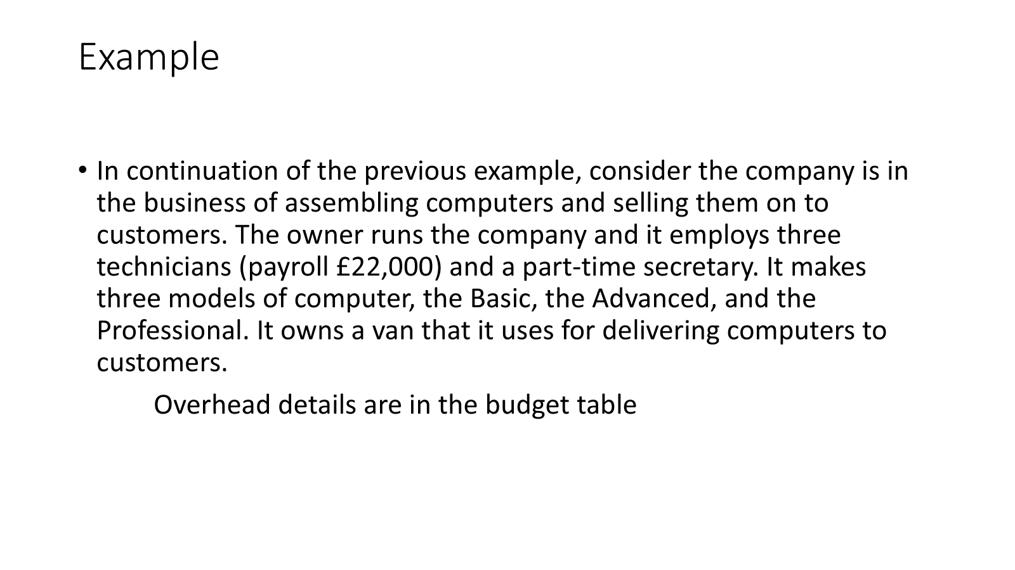

Slide 6
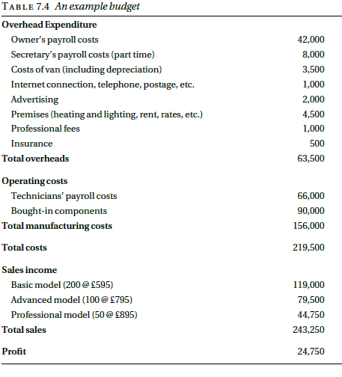
Example

Slide 7
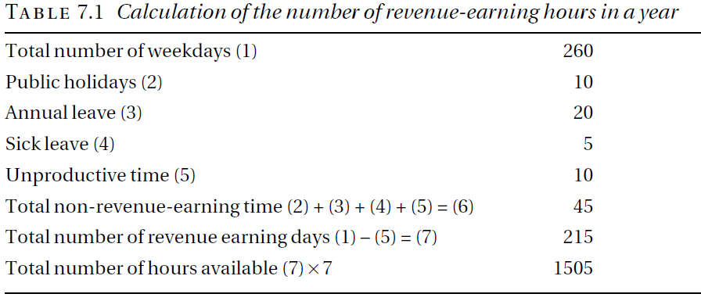
Labor working hours calculation

Slide 8
Payroll
The total cost of employing a person, that is, the salary plus employers’ social security contributions plus any other costs associated directly with the employee, is sometimes known as the employee’s payroll cost or direct cost.
Consider a technician who is employed to assemble the computers, and suppose that he is paid an annual salary of £20,000. His payroll costs are £22,000.
The direct cost of the technician is £22,000 per year so the direct cost of an hour of their time is £22000/1505 = £14.62.

Slide 9
Cost of Labor
There are many costs that we have ignored. Even if our technician works as a sole trader, with no assistance, there will be other costs.
He has to pay for a computer, which costs £200, and it takes 10 hours of a technician’s time to assemble the computer, install the software, and configure it, so the cost of constructing the finished product is £200 + 10 × £14.62 = £346.20.

Slide 10
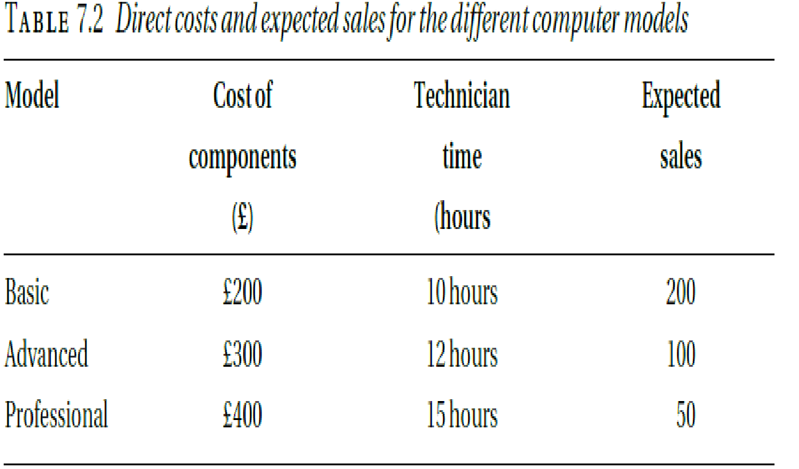
Example 1- Solution
Given:
Overhead cost = 63,500, # of technicians =3
Pay = 22,000, # of labor hours = 1505
Labor per hour cost = 22,000/1505 = 14.62
Notes:
Since we expect to sell 350 units, this means £181.43 per computer(overhead calculated from budget total over head is 63500 in table 7.4). This
means that the Basic model would cost
£181.43 + £200 + 10 × £14.62 = £527.63
The Advanced model would cost
£181.43 + £300 + 12 × £14.62 = £651.83
and the Professional model would cost
£181.43 + £400 + 15 × £14.62 = £802.23
The second way of allocating the overhead is to make it proportional to the
number of hours of labour involved. This means adding an overhead component
to the cost of an hour of a technician’s time. Since we have three technicians,
each supplying 1,505 hours of productive labour per year, we need to add
£63500/(3 × 1505) = £14.06
to the cost of an hour’s labour, making it up to £14.62 + £14.06 = £28.68. Now
the cost of the three models comes out at:
£200 + 10 × £28.68 = £486.80 (Basic)
£300 + 12 × £28.68 = £644.16 (Advanced)
£400 + 15 × £28.68 = £830.20 (Professional)

Slide 11
1. Fixed Overhead
Overhead over expected sale = 63,500/350 = £181.43
Basic model would cost:
£181.43 + £200 + 10 × £14.62 = £527.63
Advanced model would cost:
£181.43 + £300 + 12 × £14.62 = £651.83
Professional model would cost:
£181.43 + £400 + 15 × £14.62 = £802.23

Slide 12
2. Overhead Proportion to Labor Content
£63500/(3 × 1505) = £14.06
Cost of an hour’s labor = £14.62 + £14.06 = £28.68.
Now, the cost of the three models comes out at:
£200 + 10 × £28.68 = £486.80 (Basic)
£300 + 12 × £28.68 = £644.16 (Advanced)
£400 + 15 × £28.68 = £830.20 (Professional)

Slide 13
3. Overhead Proportion to total cost direct
To calculate this percentage, we divide the total overhead by the total direct cost of all the units we expect to sell.
£200 + 10 × £14.62 = £346.20
£300 + 12 × £14.62 = £475.44
£200 + 10 × £14.62 = £619.30
Now, 350 sales
63500/(200 × 346.20 + 100 × 475.44 + 50 × 619.30) = 0.43.
Factor = 1 + 0.43 = 1.43 (+1 is the factor added per 1 unit)
The basic model is £346.20 × 1.43 = £495.06.
Advanced model, £679.88
Professional model, £885.60.

Slide 14
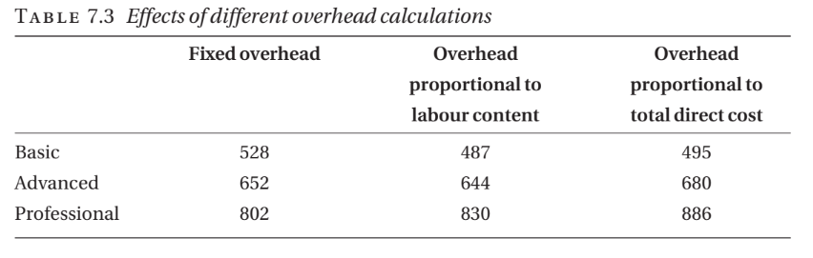

Slide 15
BUDGETING
A budget is a financial plan showing the expected income and expenditure for an organization over a specific period, typically one year.

Slide 16
BUDGETING
For many reasons, particularly with taxation and social security, owners should treat themselves as employees and pay themselves a salary, rather than attempt to live on the company’s profits. This accounts for the item labeled ‘Owner’s payroll costs’.
The services of an accountant will be necessary to help prepare the annual accounts and possibly to advise from time to time. The advice lawyer may also be necessary from time to time. These items are covered under the heading ‘Professional fees’.
Finally, employers are legally required to carry insurance to cover any claim against them for injuries suffered by employees during their employment; other insurance, against theft from the company’s premises for example, may also be necessary. This explains the heading ‘Insurance’.

Slide 17
CASH FLOW FORECAST
A company may be very profitable but unable to pay its bills. For that reason, it may be forced into receivership. This apparent paradox typically arises because bills have to be met, in particular staff have to be paid, before the income they generate is received. To avoid this difficulty businesses, need to prepare cash flow forecasts, that is, estimates of the amount of money that will flow into and out of the company each month.
companies normally try to forecast twelve months.

